Slide 1
Workplace Safety, Insurance Facts & Figures
By: Brad Valley, Jennifer Aziz, Matt Ferguson, & Shavanni Singh
Provincial Building & Construction Trades Council of Ontario
67th Annual Convention
October 16th 2024 Windsor, Ontario

Slide 2
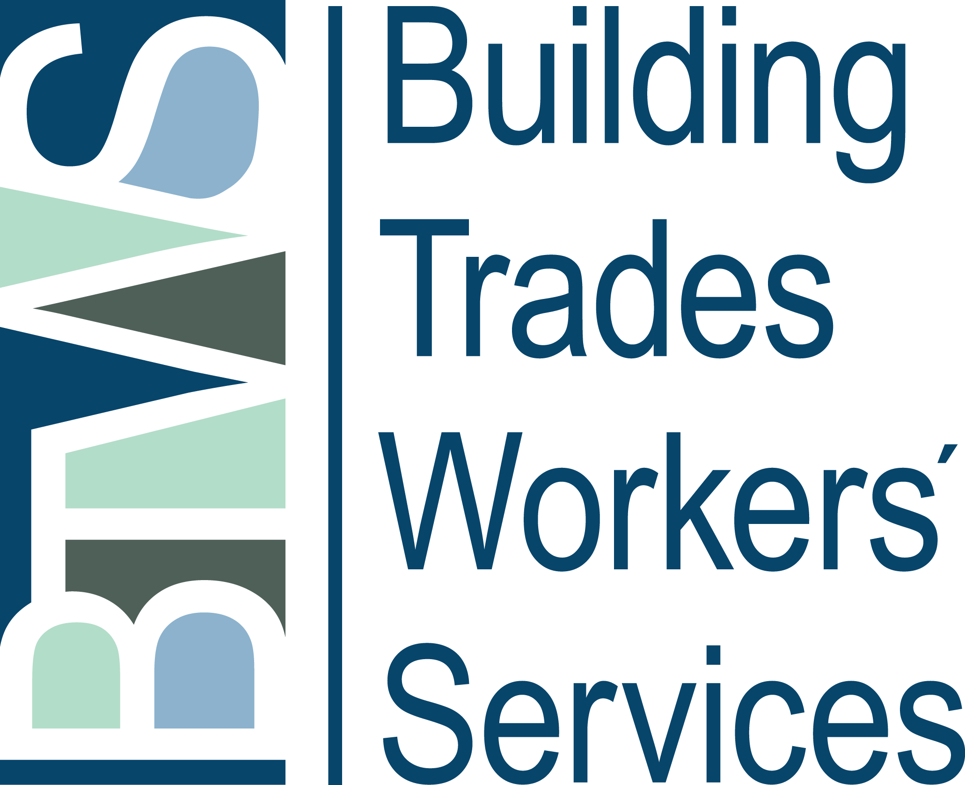
Building Trades Workers’ Services
Legal representation for injured workers in the Building Trades since 1994.
Owned and operated by unions on a not-for-profit basis.
Open for membership for any Building Trades local union.

Slide 3
Brief History of Workers’ Compensation
Before workers’ compensation legislation, if you were injured at work, you would have to sue your employer.
Historic Compromise:
Employers fund the workers 'compensation system, and injured workers surrender the right to sue their employer for injury.
Five basic concepts that underlie most workers’ compensation legislation in Canada today.
AKA the Meredith Principles

Slide 4
The Meredith Principles
No-fault compensation
workers are paid benefits regardless of how the injury occurred
Security of benefits
fund is established to guarantee funds exist to pay benefits
Collective liability
covered employers share liability for workplace injury insurance
Independent administration
Workers’ compensation boards’ are separate from government
Exclusive jurisdiction
only workers’ compensation boards provide workers’ compensation insurance

Slide 5
Workers’ Compensation Legislation in Ontario
Pension
Pre 1985
75% Gross
Pension
1985 – 1989
90% Net
Dual Award
FEL/NEL
1990 -1997
90 % Net
Dual Award LOE/NEL
1998 - Present
85% Net

Slide 6
Pension Model
Pre Bill 101
Accident Dates
Prior April 1, 1985
Earnings Basis
75% of 4 Weeks Gross earnings prior to accident
Benefit Type
Temporary Benefits
Pensions
Bill 101
Accident Dates
April 1, 1985 – January 1, 1990
Earnings Basis
90 % of NAE (Gross less income tax, UI, and CPP)
Benefit Type
Temporary Benefits
Pensions

Slide 7
Dual Award System Model
Bill 162
Accident Dates
January 2, 1990 – December 31, 1997
Earnings Basis
90 % of NAE (Gross less income tax, UI, and CPP) + 10% LRI
Benefit Type
Temporary Benefits
Non Economic Loss (NEL)
Future Economic Loss (FEL)
Bill 101
Accident Dates
April 1, 1985 – January 1, 1990
Earnings Basis
90 % of NAE (Gross less income tax, UI, and CPP)
Benefit Type
Temporary Benefits
Pensions

Slide 8
How the System is Funded
Workers’ Compensation Boards are funded by employers (not by government or workers – at least directly)
Employers are charged a certain dollar amount per $100 of payroll
This amount is known as the “assessment rate” or “premium”
Not all employers pay into workers’ compensation; this depends on the legislation of each province/territory

Slide 9
How is the System Funded – the “Accident Fund”
The money collected from employers goes into a fund, referred to as the Accident Fund.
In general, monies from this fund go toward:
providing wage loss benefits to workers injured on the job who are unable to work due to a work injury;
providing medical aid and rehabilitation to workers injured on the job; and
the general administration of the Workers’ Compensation Board

Slide 10
Employer premium decreases since 2016
Decreasing employer premiums in construction 60% since 2016
Further gifting $1.5 billion to all employers by WSIB (2022)
Unfunded Liability (UFL) was the shortfall between the money needed to pay future benefits and the money in our insurance fund.
WSIB’s UFL in 2014 was $14.2 billion
By September 26, 2018 the WSIB announced the elimination of the UFL
WSIB achieved a100% funding ratio nearly a decade ahead of the legislated timeline of 2027

Slide 11
How to calculate premiums and insurable earnings
To calculate premiums, the employer multiplies employees’ gross insurable earnings by the premium rate and divides by 100
Premium = insurable earnings x premium rate ÷100
Example:
Employer in G2 “Infrastructure Construction” has 10 employees with total gross insurable earnings $800k with a premium rate in 2023 of $1.81
$800,000 x $1.81 ÷100 = $9,440

Slide 12
Construction Employer Premiums & Rate Groups
In Ontario there are six classes of construction employers
Rate reductions for 2023 (amount per $100 of payroll) are as follows:
G1 Residential Building Construction, 2023 class rate $2.47, 2022 rate $2.63
G2 Infrastructure Construction, 2023 rate $1.81, 2022 rate $2.12
G3 Foundation, Structure and Building Exterior Construction, 2023 rate $3.60, 2022 rate $4.12
G4 Building Equipment Construction, 2023 rate $1.50, 2022 rate $1.70
G5 Specialty Trades Construction, 2023 rate $2.16, 2022 rate $2.36
G6 Non-residential Building Construction, 2023 rate $1.55, 2022 rate $1.79

Slide 13
Maximum Gross Insurable Earnings
All provides have legislation setting out a yearly MAXIMUM gross insurable earnings
In Ontario, the maximum gross insurable earnings for 2024 that an employer pays premiums on is $112,500.
Example:
A worker has gross earnings of $145,000 for the calendar year. The WSIB maximum amount of insurable earnings for 2024 year is 112,500. The employer is, therefore, responsible to pay premiums on the worker's insurable earnings until the annual maximum of $112,500 has been reached.

Slide 14
Maximum Assessable/Insurable Earnings Provincial Comparison
Provinces | 2023 | 2024
Newfoundland and Labrador | $72,870 | $76,955
Prince Edward Island | $65,000 | $78,400
Nova Scotia | $69,800 | $72,500
New Brunswick | $74,800 | $76,900
Québec | $91,000 | $94,000
Ontario | $110,000 | $112,500
Manitoba | $153,380 | $160,510
Saskatchewan | $96,945 | $99,945
Alberta | $102,100 | $104,600
British Columbia | $112,800 | $116,700
Yukon | $98,093 | $102,017
Northwest Territories and Nunavut | $107,400 | $110,600

Slide 15
Maximum Insurable Earnings & Workers’ Benefits post 1998 claims
WSIB pays compensation for loss of earnings (LOE) on the basis of 85% of the worker’s “net average earnings” from employment.
Net average earnings for this purpose is generally calculated by deducting Canada Pension Plan (or sometimes Quebec Pension Plan) contributions, unemployment insurance premiums and income tax from gross income
In Ontario, the maximum gross insurable earnings is set at $112,500 a year for 2024

Slide 16
What's the maximum a worker can receive from WSIB in weekly loss of earnings (LOE) benefits?
Maximum weekly WSIB LOE rate in 2024 is $1352
Based on the maximum earnings ceiling of $112,500/year ($2163/weekly) gross
Net average earnings after deductions results in net average weekly earnings of $1592
NAE weekly earnings ($1592) x 85% = $1352 in full LOE benefits

Slide 17
Construction workers earn above the maximum earnings ceiling
In the construction sector, a large majority of workers earn well above the $112,500k maximum.
Therefore, when a worker sustains an injury, they are already taking a financial hit.
Then on top of that, they are only receiving at maximum 85% of their net take home pay.
Example:
Pre-injury worker was earning $2200 per week net
Post-injury on WSIB earning $1352/week in full LOE benefits
Net loss of $848 per week

Slide 18
Short Term vs Long Term Earnings
Short-Term Earnings
Based on actual earnings from all employers at the time of accident.
First twelve (12) weeks, in most cases, based on actual earnings at the time of injury.
The WSIB will typically look at the four (4) weeks pre-injury to set the rate.
Mandatory overtime is included. Voluntary overtime is also included if the worker worked it in each of the 4 weeks.

Slide 19
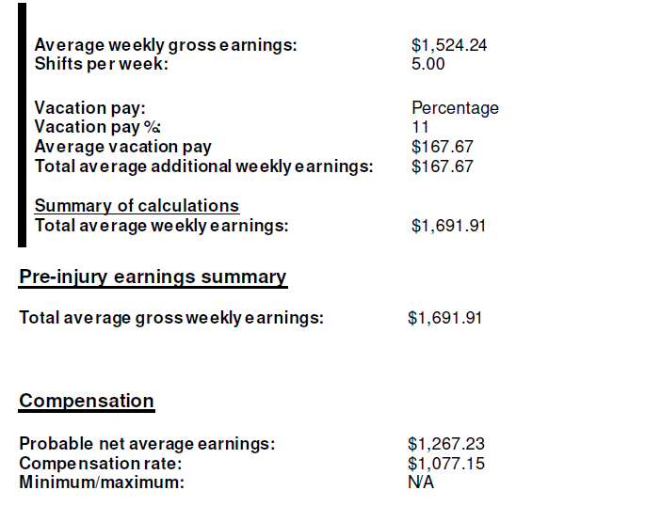
Example from WSIB File – Short-Term Rate
**No OT worked in 4 weeks prior **

Slide 20
Earnings LOE – Long-Term
Long Term Earnings
The WSIB will review to see if a Long-Term Rate Recalculation is needed for the 13th week.
For permanent employees, the short-term and long-term rates can be the same, therefore no recalculation. However, if it is unfair to continue paying at the short-term rate, the WSIB may conduct a long-term rate recalculation.
For non-permanent employees, the WSIB will automatically recalculate the long-term rate.
The WSIB will request earnings information generally for two years before accident and re-determine the average weekly earnings.

Slide 21
Earnings LOE – Long-Term
To simplify the process of gathering the worker's past earnings information, the 24-month period may be either:
Extended to include the two full calendar years before the injury, plus the current year up to the date of injury, or
Shortened to the full calendar year before the injury, plus the current year up to the date of injury, provided that the worker's employment pattern is accurately reflected.
If the WSIB extends/shortens the recalculation period, the WSIB may have regard to the worker's seasonal or cyclical work pattern.
If you are a seasonal worker this will usually result in a decrease in benefits.

Slide 22
Earnings LOE – Long-Term (Example)
Example
Worker injured January 1, 2023. Pre-injury NAE $1985.00 week
WSIB rate maximum LOE $1352 per week (short term rate first 12 weeks)
Severe injury with no return-to-work; WSIB accepts claim and worker receives full LOE
Worker is paid full LOE of $1352 from January 2nd to March 26th.
The WSIB calculates the LTR for the 13th week.
Calculation period (24 months)
January 1st 2021 to December 31st 2022

Slide 23
Earnings LOE – Long-Term (Example) continued
2021 total gross earnings including EI January 1st to December 31 ($63,200)
2022 total gross earnings including EI January 1st to December 31 ($59,000)
Calculation
Total earnings x 7÷ by total days (January 1st 2021 to December 31 2022) = Weekly Gross Earnings
$122,200 x 7 = $1171 (Gross Weekly Earnings)
730
$1171 = Net average weekly earnings $841.00
New WSIB rate $841.00 x 85% = $741 per week beginning in the 13th week
Short term rate was $1260 per week
The $741 per week is what all future benefits will be based on (partial LOE)

Slide 24
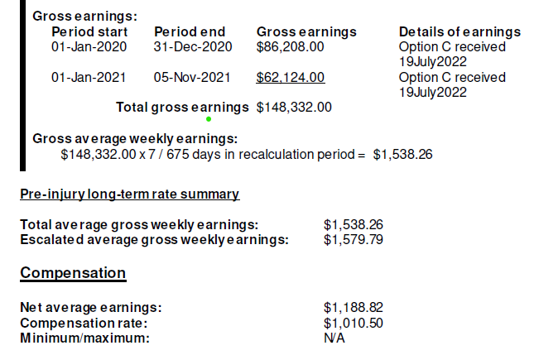
Example from WSIB File – Long-Term Rate

Slide 25
Partial LOE
PLOE Benefits = 85% x [pre-injury net average earnings (NAE) - post injury (NAE)
If a worker returns to work while they are still suffering a work-related impairment and are paid less than what they earned before injury, the amount of LOE benefits will be 85% of the difference between what they earned before injury and what they are earning after injury.
Partial LOE is also paid in situations when a worker is retrained by the WSIB and either is deemed to be employed and or finds a job paying less than pre-accident earnings.

Slide 26
What are Deemed Earnings
If a worker is unable to perform their pre-injury job and goes through Work Transition Services, they will be re-trained into a “Suitable Occupation.”
With the WSIB practice of “deeming” (also called Determining), the WSIB decides you can earn the wages of the “Suitable Occupation”, whether you are employed or not.
If a worker is retrained in the Suitable Occupation but unable to find a job, the WSIB will determine/pretend they have a job.
The Board can then reduce or eliminate your benefits by ‘deeming’ you to be receiving the wages from a job that you do not have and have no real hope of getting.

Slide 27
Example Deeming & Partial LOE
Formula (Full LOE – actual or determined wages (with or without retraining) = partial LOE
$1260/Full LOE = pre-injury Net Average Earnings
$800 (Gross Earnings) determined earnings from $20/hr in customer service.
$800 (NAE- after taxes, EI, CPP deductions) = $591 Net
85% x ($1260-$591) = 85% x $669 = Weekly PLOE rate of $568.65
Monthly from WSIB $2462.25
Yearly $29,547
Potentially up until 65

Slide 28
How Long LOE Paid
LOE benefits are paid until the earliest of:
The day on which the worker’s loss of earnings ceases
The day on which the worker reaches 65 years of age
Two years after the date of injury if the worker was 63 years of age or older on the date of injury, or
The day on which the worker is no longer impaired as a result of the injury.

Slide 29
Older Workers and LOE Benefits
The current law only permits workers to access WSIB LOE benefits until they turn 65 or for a maximum of two years if they get injured at 63 or older.
Older workers over 65 who get injured still receive health care and if they sustain a permanent impairment are entitled to a NEL award.
As more Canadians remain in the workforce beyond 63, the law is not keeping with the times and the trend of older worker injuries.
From 2012 to 2023, the number of WSIB lost time claims for workers aged 60 to 64 increased by 73 per cent — and for workers 65 or older by 164 per cent.

Slide 30
Tips for members referred to BTWS
Ask the injured/ill worker to gather their financial documents to send to us after the referral is made
Notices of Assessment or Option C printouts for 3 years pre-injury
ROEs
T4s
T4Es
Dates of EI claims

Slide 31
Dependent Contractors
WSIB has separate policies for those in construction who operate as dependant contractor.
To be considered a dependent contractor, the worker must be covered under the contractor's WSIB account at the time of injury.
A dependent contractor may report as a self-employed individual for income tax purposes with the Canada Revenue Agency (CRA).
These can be union members but style themselves as dependent contractors (dry wallers, tappers, flooring etc).

Slide 32
Dependent Contractors: How Does WSIB Calculate Average Earnings?
A dependent contractors average earnings are generally calculated based upon a 12- month period prior to the date of accident or lesser period if there is a break in employment.
The WSIB uses the net business income during the calculation period based on the income reported to:
1. CRA or
2. An audited financial statement of earnings prepared by a chartered accountant.

Slide 33
Dependent Contractors: How Does WSIB Calculate Average Earnings?
Example: LOE benefits = 85% x pre-injury net average earnings (NAE) – actual post-injury NAE.
Dependent contractor reports total income after expenses of $29,000 (gross)
Calculation
$29,000 x 7 ÷ 365 = $556.16 weekly gross earrings (before tax)
$556.16 gross = $413 NAE (after tax)
WSIB LOE $413 x 85% = $351.05 (weekly)
Key take away the lower the income dependent contractors report it will impact WSIB benefits.

Slide 34
WSIB Coverage for Apprentices
Who is an apprentice?
Registered under the Trades Qualifications and Apprenticeship Act.
Signed a contract of apprenticeship for training and instruction in a trade, through or from an employer.
Includes high school students participating in the Ontario Youth Apprenticeship Program.
The provincial government pays for the cost of coverage for participants in the Ontario Youth Apprenticeship Program.
Coverage is provided during the work placement but not during classroom courses.
For more information on what an apprentice is and an apprenticeship check out Construction Training and Apprenticeship Ontario (CTAO) ctaontario.ca

Slide 35
WSIB Coverage for Apprentices: How are pre-injury average earnings calculated for apprentices?
Based on the average earnings of a typical journeyperson employed by the employer at the time of the accident and in the same trade as the apprentice, even if it is higher than the apprentice’s actual wages.
If the employment pattern of a typical journeyperson employed by the employer is non-permanent (i.e., seasonal employment pattern), wages and hours worked at the time of the accident may not be an accurate reflection of the journeyperson’s average earnings.
Consideration should be given to calculating the initial average earnings based on the wages earned by the journeyperson in the 24 months prior to the injury to better reflect the journeyperson’s actual average earnings.

Slide 36
Coverage for Students in Work Education Program
Students participating in work education or experiential learning programs must be at least fourteen years of age.
Students who participate in work education or experiential learning programs and who do not receive wages are considered, for the purpose of coverage under the Act, to be employees of the Ministry of Education once the Work Education Agreement (WEA) form is completed and the work placement begins.
If there is no (WEA) all other participants have no WSIB coverage.
If students do receive wages when participating in work education or experiential learning programs, the placement employer is considered to be the employer under the WSIA, and is responsible for providing WSIA coverage.
Unpaid work placements – benefits are based on the minimum wage.
Most students participating in work education programs do not receive wages; however, the deemed rate of pay for calculating loss of earnings benefits is the general hourly rate established by minimum wage legislation.

Slide 37
Benefits for Permanent Impairment: Non-Economic Loss Award
If a worker has a permanent impairment due to a work-related injury or illness, they are eligible for a non-economic loss benefit.
A non-economic loss benefit is paid when there is an ongoing impairment after a work-related injury or illness that has reached a point where it is not expected to improve.
This point is called the maximum medical recovery date.
The Act defines “permanent impairment” as a physical or functional abnormality or loss (including disfigurement) which results from an injury and any psychological damage arising from the abnormality or loss that continues to exist after you reach maximum medical recovery.

Slide 38
Benefits for Permanent Impairment: Non-Economic Loss Award
A non-economic loss benefit is not related to any loss of earnings benefit a worker may be receiving and may not be related to the ability to work.
A non-economic loss benefit compensates based on the degree of permanent impairment.
The Act says the WSIB must use the evaluation criteria set out in the American Medical Association Guides to the Evaluation of Permanent Impairment, Third Edition, Revised when they decide the degree of permanent impairment.

Slide 39
Benefits for Permanent Impairment: Non-Economic Loss Award
For example, a complete amputation of the index finger represents a 100% impairment of the finger.
The 100% impairment of the finger represents a 20% impairment of the hand.
The 20% impairment of the hand represents an 18% impairment of the arm, and the 18% impairment of the arm represents an 11% impairment of the entire body.

Slide 40
Example of a Non-Economic Loss benefit calculation
The WSIB decides the dollar value of a non-economic loss benefit by multiplying the whole person impairment percentage by a base dollar value.
The base dollar amount is set out in the Act.
To calculate a non-economic loss benefit, the WSIB uses the base amount for the year they reached maximum medical recovery.
This base amount is then adjusted according to the workers age at the time of the injury.
There is an age adjustment amount that is added for every year the worker was under the age of 45 at the time of the injury, or subtracted for every year they were over 45, up to a maximum of 20 years.

Slide 41
Example of a Non-Economic Loss benefit calculation
A worker is 52 years old at the time of injury (7 years over age 45) and they reached maximum medical recovery in the year 2018
The base amount for people whose maximum medical recovery date is in 2018 is $59,981.69 , and the adjustment amount is $1,333.42 .
As a result, the WSIB reduces the base amount of $59,981.69 by the age adjustment factor of ($1,333.42 x 7) to get the adjusted base amount:
$59,981.69 - ($1,333.42 x 7) = $50,647.75 (adjusted base amount)
They multiply the adjusted base amount by whole person impairment percentage to calculate the non-economic loss benefit.
If the whole person impairment is rated at 20%, the non-economic loss benefit is:
$50,647.75 x 15% = $7,597.16

Slide 42
Survivor Benefits
Lump sum awards
Surviving spouses are entitled to a one-time lump sum payment. For 2024, this payment is $98,443.63 plus or minus $2,461.08 for each year the spouse is under/over under age 40, respectively.
The amount decreases by $2,461.08 every year older than 40 that the spouse was at the time of the deceased’s passing to a minimum of $49,221.75
The amount increases by $2,461.08 every year younger than 40 the spouse was at the time of the deceased’s passing to a maximum of $147,665.34.

Slide 43
2024 Compensation Amounts for Survivors
Age | Amount
20 or younger | $147,665.34
25 | $135,359.83
30 | $123,054.43
35 | $110,749.03
40 | $98,443.63
45 | $86,138.23
50 | $73,832.83
55 | $61,527.43
60 or older | $49,221.75

Slide 44
Survivor Benefits Monthly Awards
Monthly awards
The minimum compensation amount payable for spouse and child is $2,329.12.
The maximum earnings ceiling is $112,500.00 per year (175% of average industrial wage for Ontario).
Burial awards
The Board pays all expenses reasonably connected to the burial.
There is no maximum amount.
The minimum amount payable is $3,691.63.

Slide 45
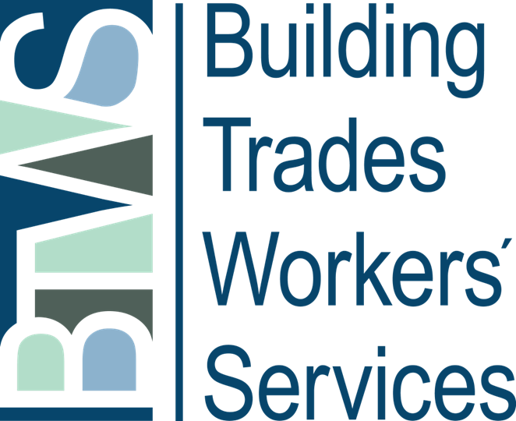
Thank you!

