Slide 1
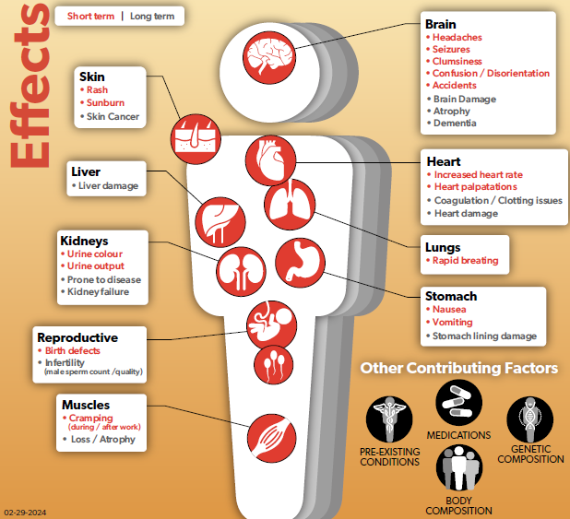
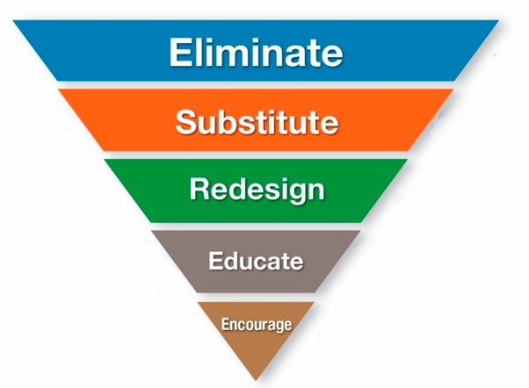
Integrated Approach at OHCOW
Notes:
The mission of the Occupational Health Clinics for Ontario Workers Inc. is to protect workers and their communities from occupational disease, injuries and illnesses; to support their capacity to address occupational hazards; and to promote the social, mental and physical well-being of workers and their families.
The hierarchy of controls as applied to an integrated approach involves 5 steps:
To eliminate hazardous working conditions.
To substitute policies to best support health & safety
Redesign the workplace to best support health & safety
To educate on health & safety
To encourage change at the worker level
The following are some workplace hazards:
•Chemicals
•Physical Agents
•Biological Agents
•Psychosocial Factors
•Human Factors
And how to control those hazards would be:
•Fatigue and Stress Prevention
•Work Intensification Prevention
•Safe Staffing
•Overtime Management
•Healthier Shift Work
•Reduction of Risks from Long Work Hours
•Flexible Work Arrangements
•Adequate Meal and Rest Breaks

Slide 2
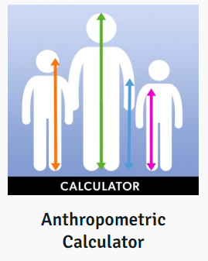
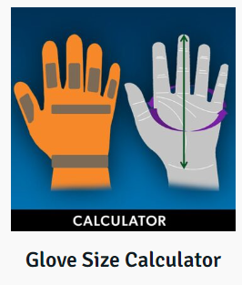
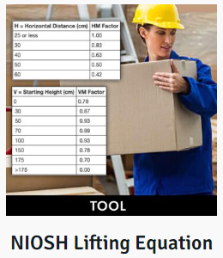
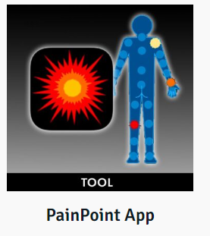
Tools for the Trades
Work
Re- Organization
Psychosocial Health
Ergonomic Consultation
Self-Management Strategies
Notes:
Prevention plays a critical role when it comes to health & safety and occupational illnesses. Questions workers may ask themselves:
How can work be re-organized or better planned to prevent illness?
What supports are needed for worker psychosocial health?
Can an ergonomist provide an assessment for the worker?
What online tools can workers use to self-manage ergonomic risks?
Look to OHCOW to help support all these questions.

Slide 3
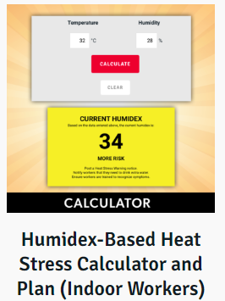
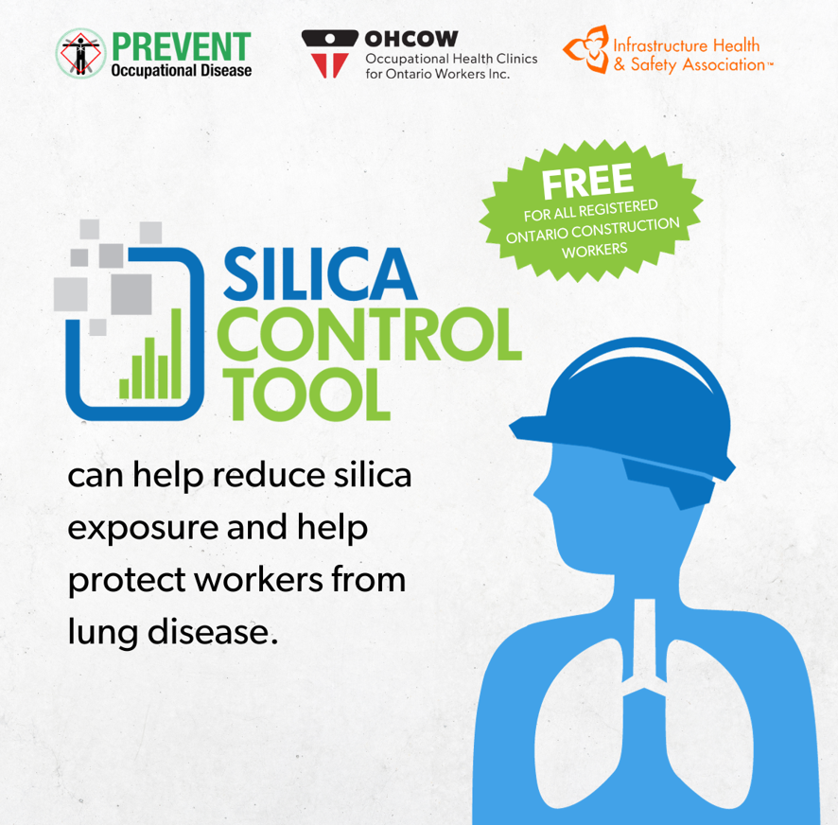
Tools for the Trades
Work
Re- Organization
Psychosocial Health
Ergonomic Consultation
Self-Management Strategies
Notes:
OHCOW’s newest online tools are the Heat Stress ToolKit and the Silica Control Tool.
Both of these online tools allow for self-management and proactive worker involvement.
The Heat stress toolkit will help a worker to better understand the heat conditions in a workplace, how to assess the risk of heat stress and how to take action to protect themselves or their coworkers. The toolkit includes:
A series of Educational Videos
The Heat Stress Calculator
Three New Reference Guides
Heat Stress Awareness Guide
Heat Stress Physiological Monitoring Guide
Heat Stress Prevention Tools and Strategies Guide
Promotional Posters
Infographics
The Silica Control Tool is a tool specifically geared towards the construction industry. Construction presents an ever-changing work environment where traditional exposure assessment strategies
are not so straightforward. A few examples of challenges faced in the construction sector include:
Work sites change rapidly
Workers and companies move between sites
Tasks vary within shift and also between work shifts
Lack of available in-house exposure measurements and occupational hygiene staff
Industry made up of many small employers (<10 employees)
The silica control tool can help to fill the gap where traditional control strategies are lacking.

Slide 4
OHCOW Holistic Services
Notes:
As part of the holistic approach to health and safety at OHCOW’s at the core of each clinic is an inter-disciplinary team of nurses, hygienists, ergonomists, client service coordinators and contracted physicians. Each OHCOW clinic provides comprehensive occupational health services and information in five areas:
An inquiry service to answer work-related health and safety questions
Medical diagnostic services for workers who may have work-related health problems
Group service for workplace health and safety committees and groups of workers
Outreach and education to increase awareness of health and safety issues and promote prevention strategies.
A research services to investigate and report on illnesses and injuries.

Slide 5
OHCOW Integrated Team
Occupational Medicine Physicians
Occupational Health Nurses
Occupational Hygienists
Ergonomists
Notes:
The integrated approach to health and safety at OHCOW includes a team of professionals.
Occupational Medicine Physicians provide medical occupational services, including initial patient assessments, assessing and diagnosing of patient symptoms and determining causal relationship of those symptoms, provide documentation for specific investigations or referrals to appropriate specialists as a result of the interview. The physicians write reports and provide other unique services to support a worker who is looking for evidence-based support for their work-related illness.
Occupational Health Nurses can help workers with the introduction of medical surveillance programs, lifestyle/wellness programs, and conducting hearing screening.
Occupational Hygienists support workers by conducting interviews and work histories. They are looking at the chemical, biological, and physical hazards that can lead to the development of workplace illnesses and can develop strategies to reduce these hazards including engineering and administrative controls such as ventilation or noise control measures.
Ergonomists fit the job to the worker. Not all workers are the same size and everyone has their own limits. Ergonomics aims to design workstations, work processes, equipment, and tools to fit the worker. OHCOW services offer ergonomic resources in the form of apps, ergonomic assessment tools as well as a vast library of information available on our website. We also offer onsite assessments.

Slide 6
OHCOW’s Community Support
Notes:
The Occupational Health Clinics for Ontario Workers is a community support which embodies the integration between prevention and protection measures against risks at work and the promotion of health and wellbeing. OHCOW strives to accomplish our mission through the identification of workplace factors which are detrimental to the health and well-being of workers; by empowering workplace parties to make positive occupational health changes in their workplace and by providing information, knowledge and organizational skills to the workplace parties to eliminate work practices that cause injury, illness and disability.

Slide 7
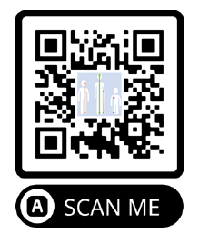
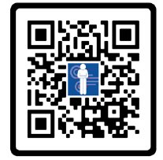
Questions?
Notes:
OHCOW will be present here tomorrow at a booth in the ballroom.
Please stop by to learn more about our tools for the trades.

